Slide 1
Intersection of Two Passions: Mathematics and Charity
Tonghai Yang
Hometown Education Foundation

Slide 2
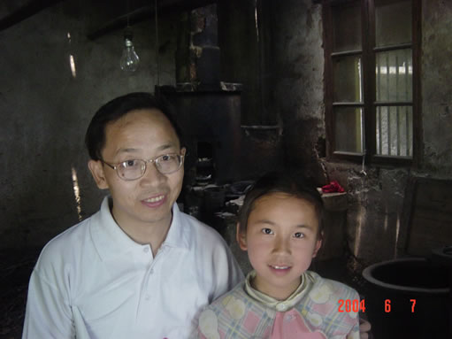
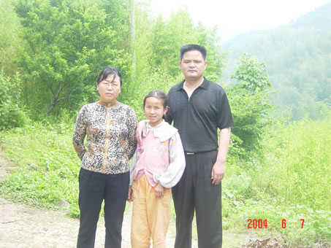
Real Impact I: Xu Shuangyue 2004-2012
Her mother is mentally disabled.
ShuangYue walks 2 miles each way to school and sometimes did not have money to buy lunch.
She started to work full time during summers in high school. She is staying local post-graduation to take care of her mother.

Slide 3
Real Impact I: Xu Shuangyue 2004-2012
Without support, she would NOT have attended or graduated from high school.

Slide 4
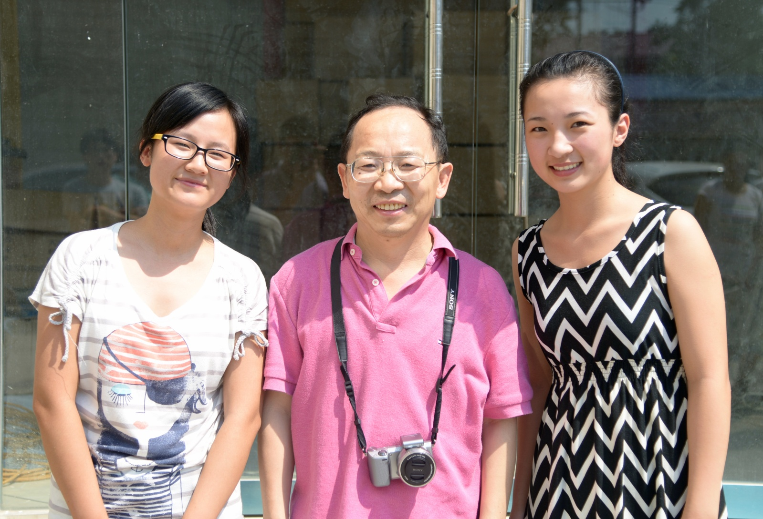
Real Impact II: Yan Limin 2004-2011
Her father died of cancer when she was in middle school.
Her mother often has migraines.
She is now a grad student at Zhejiang University, one of China’s elite colleges.

Slide 5
Real Impact III: Yuan Lei 2013-Present
Yuan Lei is a 10th grader at JingZhai High School. His mother died when he was just 3 years old. His father died recently in Feb. 2013. He now lives with his aged grandmother.
Yuan Lei is able to continue his education due to the generous support from Li Hong at Microsoft.

Slide 6
Real Impact IV---Two other cases
Notes:
Right: Shangxi YuShe 2008

Slide 7
Inspiration I: Cheng Weiyong 2005-2012
WeiYong lost both his parents at a young age.
Misfortune struck again, WeiYong lost his grandparents while in high school.
Admitted (and currently attending) a military university (fully funded education) in 2012.
Giving back to HEF!
ONCE SUPPORTED, NOW GIVING BACK

Slide 8
ONCE SUPPORTED, NOW GIVING BACK Cheng weiyong
WeiYong and 8 other volunteers went to teach for 3 weeks in a very rural area. He sponsored a young disabled girl (pictured left; left side).
Notes:
Right: Bathroom under construction

Slide 9
Inspiration II: College students
College students…
Aids HEF in sorting letters over winter break
Visit younger impoverished children to check background and encourage them
Share their (college) experiences with students and provide advice advice
Come back to sponsor poor students
Volunteer!
Notes:
Show some letters if possible

Slide 10
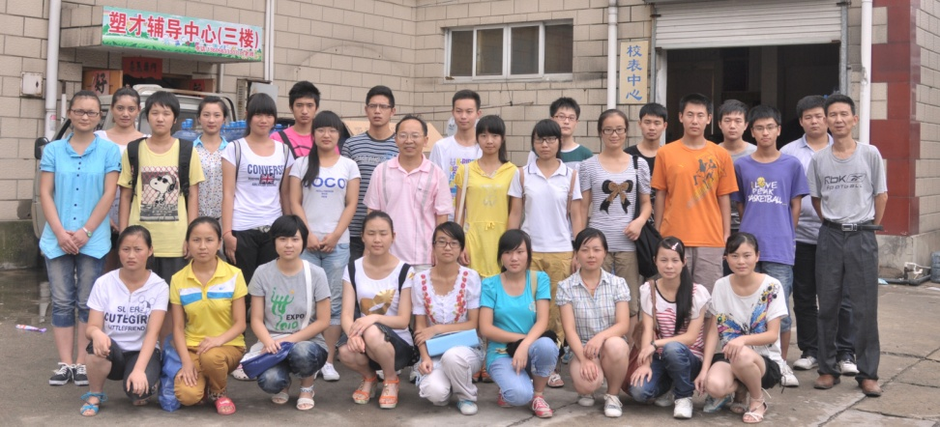
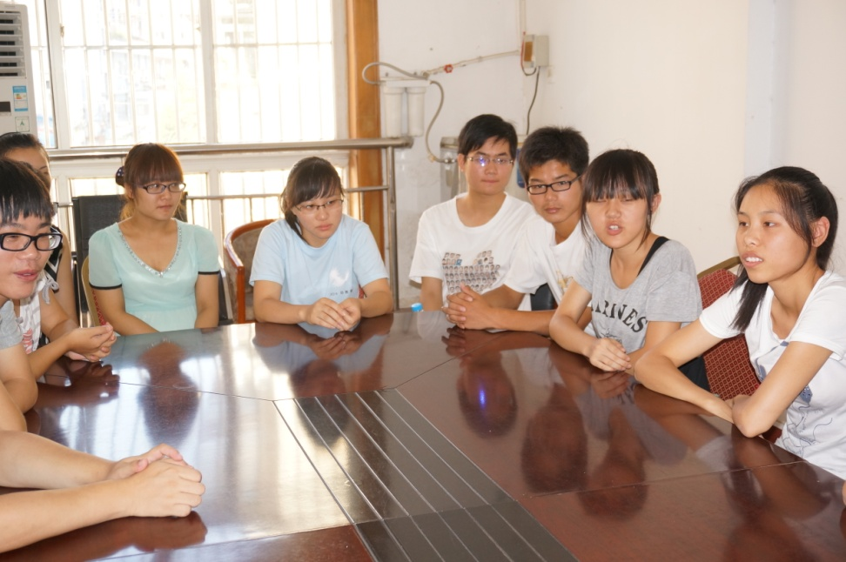
College Students giving back And sharing their experience
Notes:
Left: College students helped us sorting letters. Right: A College student visited Fang Yuhang’s home last winter break.

Slide 11
How the program works
Join force with 宁国市中美爱心 (Independent, cofounded by 胡寄宁 – Hu JiNing and myself in 2004).
Each school has a volunteer coordinator.
Teachers recommend students.
Students fill out a form.
Coordinators evaluate and approve. Mr. Hu gives final approval.
Mr. Hu, volunteers, and myself check on and visit new and old students in HEF.
Notes:
Show a form if possible

Slide 12
How the program works
Certificates are given to the students’ guardians to sign. Support money arrives next. Both processes are conducted through the school.
Sponsored students write a letter to their sponsors at least once a year. We deliver it with their transcript.
www.HometownEducation.org/letters.html
www.HometownEducation.org/photos2004.html

Slide 13
Example of student form

Slide 14
Volunteer Coordinators

Slide 15
How HEF grows
GROWTH
Your Support
Volunteers
Openness
Hard, Honest, Careful Work
100% of Donations Goes to Students
Communication – Emails and Website

Slide 16
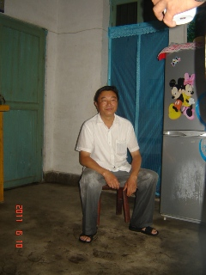
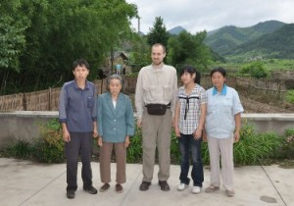
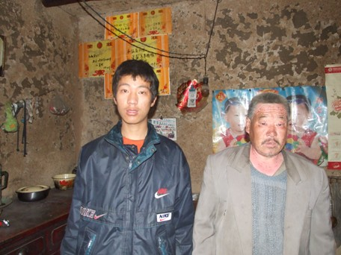
Hard Work AND INSPIRATION

Slide 17
How can you help us grow
Donation
Via our website, Paypal, check, or cash
Shop Online!
Amazon (via HEF website)
Expedia, Best Buy, Macy’s, etc. (via HEF website)
GoodShop/ GoodSearch
Sponsorship: develop a personal connection
Elem: $60 (400 Yuan RMB)
Middle: $80-100 (600 Yuan RMB)
High: $150-200 (1200 Yuan RMB)
College: ($150-800) Between 1200 and 5000 RMB
Spread the word to your friends and colleagues!
Online Shopping
Sponsorship
Donation
Spread the Word
GROWTH

Slide 18
How we are different
Our Difference
100% of Donation Goes to Students
Personal Care + Financial Support
Encourage Forward-Motion, Not Dependence
Continuous, Established
Positive Influence
Personal Connection – Letters, Pictures, Transcript

Slide 19
You will be an inspiration and positive influence…
To students
To local people – more and more people donate and like this program.
To other volunteers and myself
UW-Madison students
To your family
Notes:
Story about myself and Hu.

Slide 20
George and Victor Chan

Slide 21
UW-Madison Students Volunteers
Notes:
Left: Two students visited Pei Ziyan (his father handicapped with both hands and eyes, mother left). Right. Zhang Bingxin taught at Gangkou Middle School

Slide 22
Hu Jining (胡寄宁) Founder of 中美爱心
Notes:
Hard to find his photos---he always works behind and takes photos of others.

Slide 23
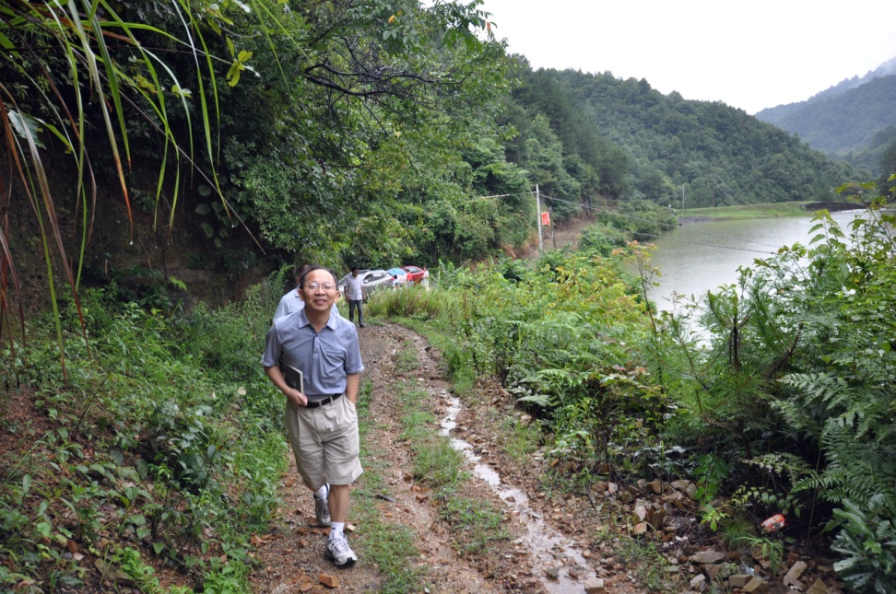
Thank You (谢谢)!
Any comments, questions, or concerns?

